Slide 1
LLM-grounded Diffusion: Prompt-induced memorization in Stable Diffusion
Literature survey
Author - Yashashwini S Awate

Slide 2
Key Research Areas
Memorization in Generative Models
Both diffusion models and LLMs are known to memorize training data.
Memorization means they can reproduce images/texts very close to what they saw during training.
Prompt-Induced Recall
Certain wordings in prompts can trigger near-exact reproductions of training images.
Example: “A photo of a woman wearing a red hat in front of the Eiffel Tower” may reproduce a copyrighted Flickr image.

Slide 3
Theme | Finding
Memorization | Stable Diffusion stores patterns from frequent or famous images.
Prompt Influence | Specific phrasing can trigger hidden memories.
LLM Role | Enhances semantic understanding of prompts.
Goal of Study | Understand why recall happens and how prompts induce it.

Slide 4
Why It Matters
Risks: copyright infringement, privacy leaks, data security.
Research challenge: understanding how prompts access stored visual memory.

Slide 5
Prompt-Induced Recall
Prompt-induced recall refers to the phenomenon where specific text prompts cause a text-to-image diffusion model (like Stable Diffusion) to reproduce images or elements from its training data—sometimes nearly identical to original samples.
Example: A prompt like
“a painting of a girl with a pearl earring, by Vermeer” often produces something visually close to the original painting — not because the model “understands” Vermeer, but because it memorized parts of it from training data.

Slide 6
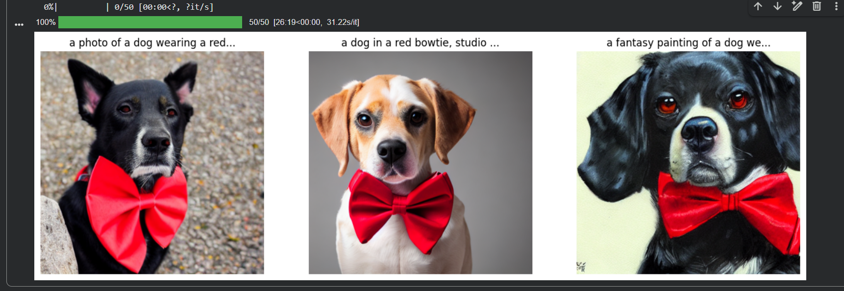
Goal: visually compare how wording changes affect the output.
Notice if the “a fantasy painting of a dog wearing a red bowtie, by greg rutkowski” prompt gives a stylistically sharper or familiar-looking result — a tiny glimpse of prompt-induced recall

Slide 7
Relevant Research and Findings
B. Somepalli et al. (2023) – “Understanding Unintended Memorization in Text-to-Image Diffusion Models”
Explored how prompts cause models to recall specific training samples.
Key Insight:
Prompts containing rare artist names, specific object combinations, or detailed captions can trigger memorized images.
Changing the wording slightly often breaks the recall link.

Slide 8
D. Lian et al. (2023) – “LLM-grounded Diffusion: Enhancing Prompt Understanding of Text-to-Image Diffusion Models with Large Language Models”
Proposed combining Large Language Models (LLMs) with diffusion models to enhance prompt understanding.
The idea: LLMs (like GPT-3 or T5) expand or clarify the user’s prompt before passing it to the diffusion model.
Example:User prompt → “a cozy mountain cabin”LLM-expanded prompt → “a cozy wooden cabin surrounded by pine trees, soft snow, and sunrise light, in cinematic detail”
This improves semantic grounding, reduces ambiguous generations, and helps study which details lead to recall.Importantly, it helps us analyze how richer textual cues influence memorized outputs.

Slide 9
Carlini et al. (2023) – "Extracting Training Data from Diffusion Models"
Researchers showed that Stable Diffusion can reproduce exact training images if given specific prompts.
They tested thousands of prompts and found that about 1% of generated images were near duplicates of training samples.
Key insight: memorization depends on repetition frequency (how often a sample appears in training) and prompt specificity.

Slide 10
Visual Concept
[Text Prompt] → [Text Encoder (CLIP/T5)] → [Latent Embedding]
↓ ↑
(LLM Expansion - adds context) |
↓ |
[Diffusion Process] → [Generated Image] ← [Training Data Influence]

Slide 11
Comparative Insights
Aspect | What We Know | Key Source
Why memorization happens | Rare, overrepresented, or unique data cause memorization | Gu et al. (2023)
When it appears | Long training, small datasets, specific prompts | Somepalli et al. (2023)
How to detect it | Image-text similarity metrics, benchmarks | MemBench (2024)
Where it lives | Localized neurons in UNet | Finding NeMo (2024)
How to prevent it | Regularization, data filtering, unlearning | Chen et al. (2024)
How LLMs help | Better prompt interpretation → less recall | Lian et al. (2023)

Slide 12
Current Gaps in Research
Despite strong progress, there are still open questions:
Prompt Sensitivity: Why do certain words or styles trigger recall?
Semantic Memory: Do models memorize meanings or visual features?
Cross-model behavior: Does memorization differ between SD v1.5, v2.1, DALL·E, and Imagen?
Impact of LLM grounding: Does improved prompt structure reduce memorization or just change its form?
Ethical dimension: How do we measure acceptable “creative memory” vs unethical recall?

